Slide 1




MINDMOTION
GIVING INDEPENDENCE BACK, ONE SIGNAL AT A TIME.

Slide 2


LARANA, INC.
LAYLA
Imagine Layla — a mother and gardener — who hasn’t felt the use of her right hand in five years. She learned to watch others tie shoelaces, hold a child’s hand, or clip a rose, thinking those small moments were lost.

Slide 3

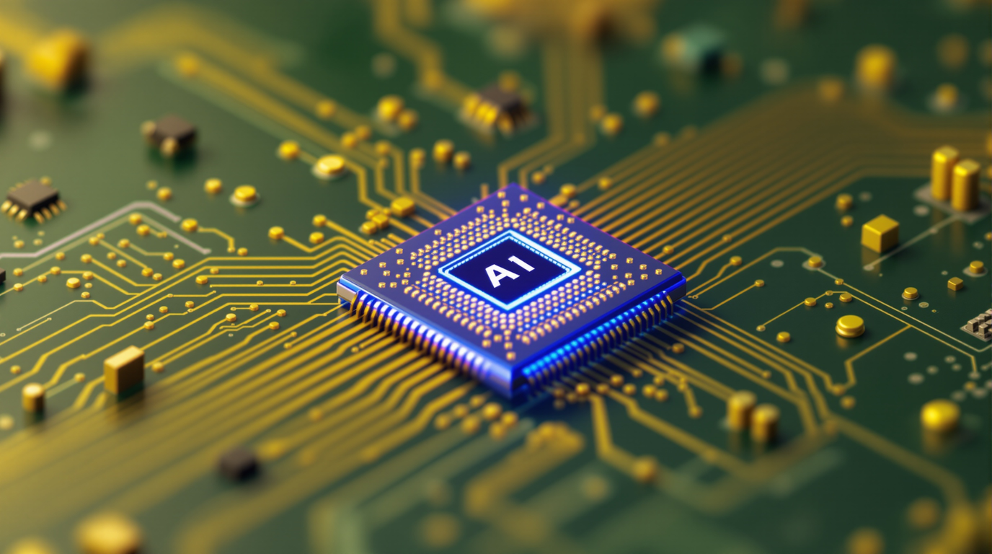
LARANA, INC.
LYLA
Now imagine a tiny AI chip translating her intent into gentle signals: for the first time in years she feels a fingertip close and squeezes her daughter’s hand — a single glowing tear and a laugh say everything words can’t.

Slide 4
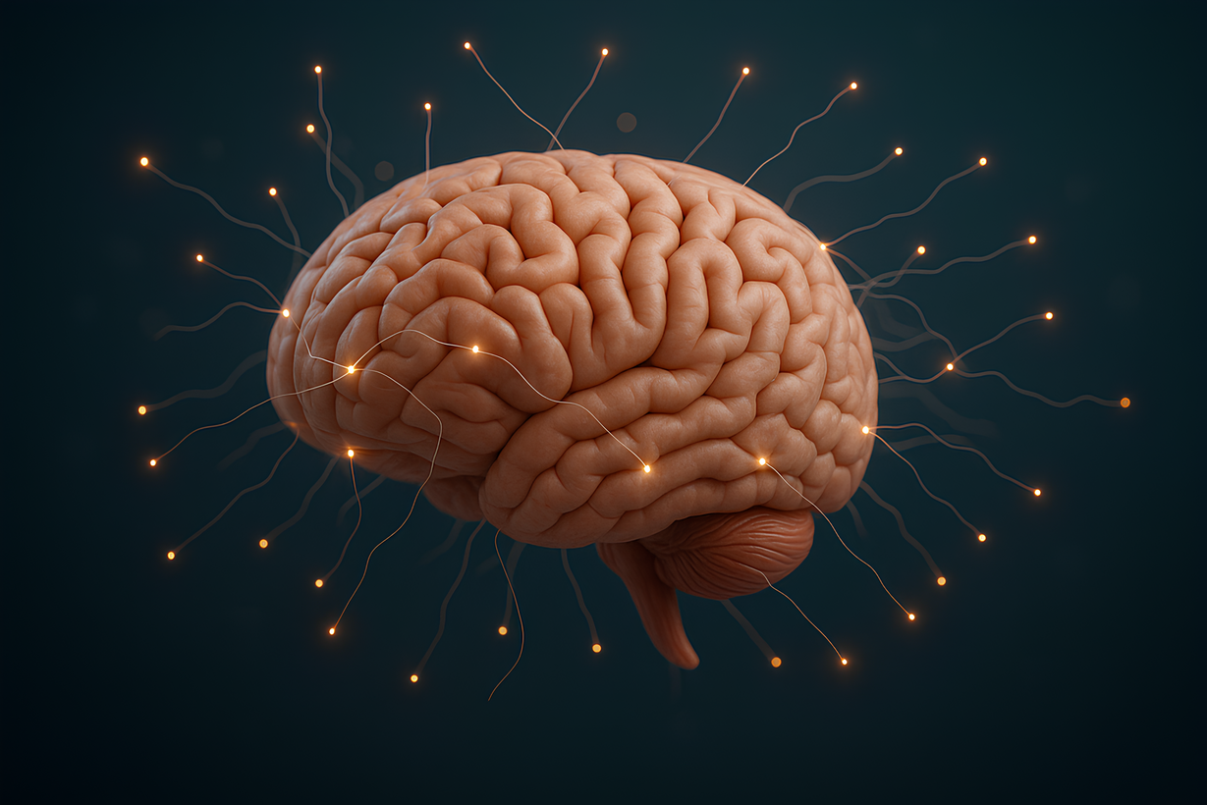

LARANA, INC.
THE PROBLEM
Millions live with paralysis, losing independence in daily life
Current solutions are expensive, invasive, and limited
Brain-computer interfaces face major security risks
Notes:
Layla’s story is not unique — millions live like her. The truth is, paralysis robs people of small daily joys. Existing solutions either cost too much, are not secure, or simply don’t work well enough

Slide 5
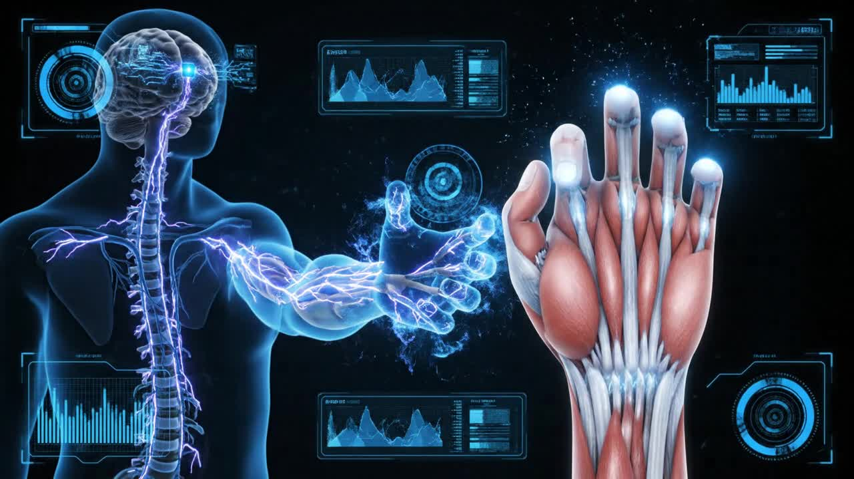
OUR SOLUTION: MINDMOTION
Tiny AI chip translates brain signals into movement.
Secure and efficient: protects data from cyber risks.
Restores independence, small, cost-effective, and scalable.
Notes:
MindMotion is a compact AI-powered chip that interprets neural signals to restore movement. It’s secure, efficient, and designed for real-world use. This is how we reconnect intent with action.

Slide 6
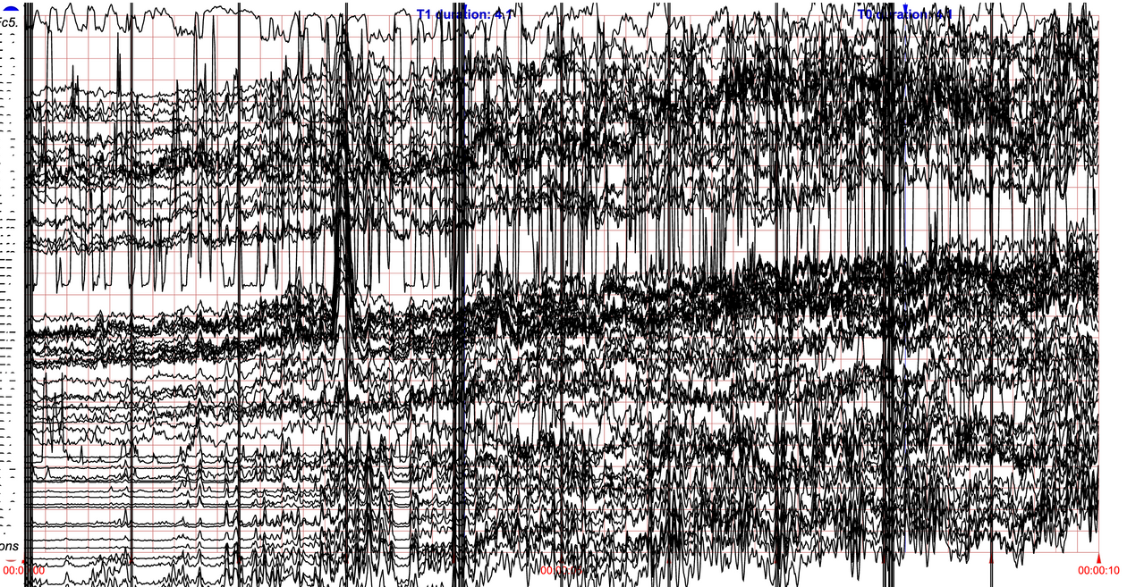
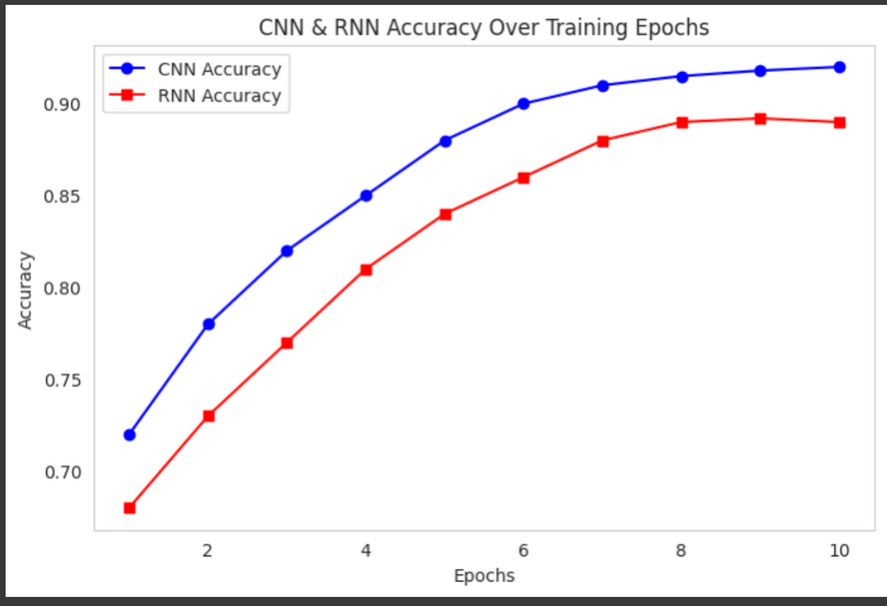
HOW IT WORKS: AI IN MINDMOTION
Reads brain signals (EEG).
AI model decodes intent (e.g., move hand).
Chip converts it into electrical stimulation.
Secure transfer prevents hacking.

Slide 7
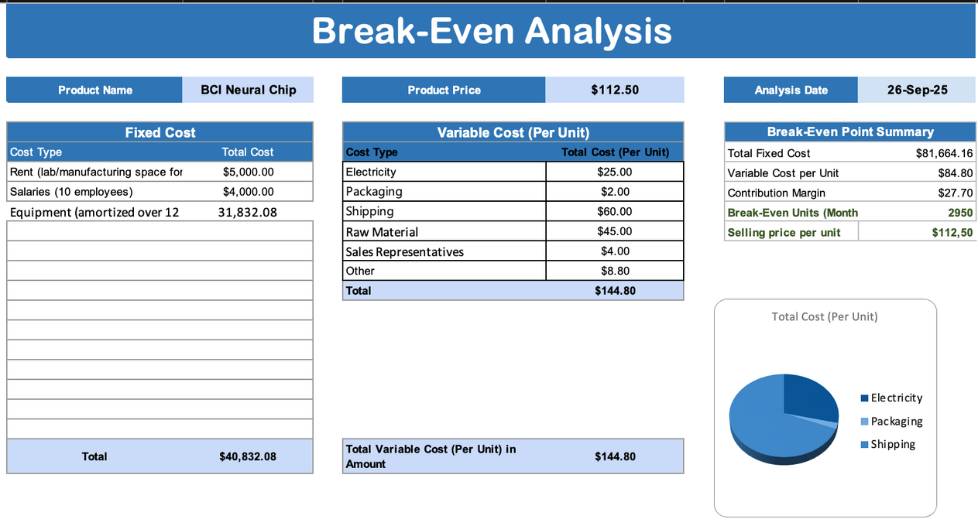
FROM IDEA TO MARKET: NEURONOVA STARTUP PLAN
Total startup capital: $390,000 (balanced sources).
Operating & Marketing costs optimized at $203,000/month.
LoBreak-even point: 2,950 units per month at $112.50 per unit.
Projected revenue: $711,000 with profitability within Year 1.
Notes:
Not only is MindMotion technically sound, it’s also financially viable. With a break-even point at just 3,500 chips per month, NeuroNova has a clear path to sustainability.
With production costs around $300, we can bring MindMotion to patients at a market price of $700 — making it more affordable than traditional neuroprosthetics that cost $10,000+

Slide 8
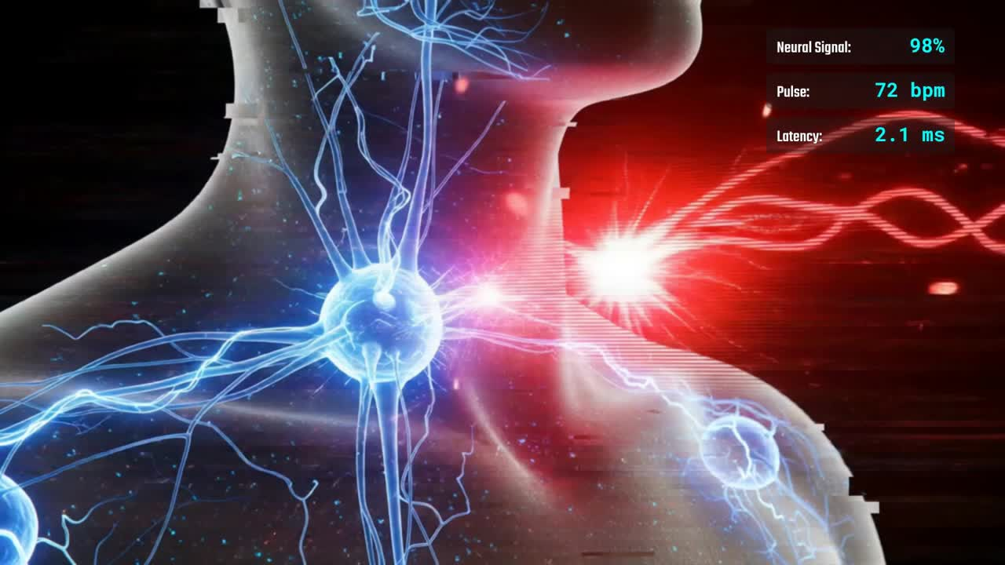
FROM CONCEPT TO SIMULATION
Silicon wafer – foundation for the chip circuitry.
Copper interconnects – for high-speed electrical signal flow.
Biocompatible coating (e.g., Parylene-C) – protects the chip and makes it safe inside the body.
Electrodes (platinum/iridium) – for stable and safe neural stimulation.
AI processing core (ASIC/FPGA) – specialized unit for brain-signal decoding
Encapsulation layer – seals the chip against moisture and corrosion.
Notes:
Here’s the journey: we started with a vision, selected materials that work safely with the body, built and trained the AI model, and finally ran simulations. The result? MindMotion is not just an idea — it’s a validated concept with proven performance, ready for real-world trials

Slide 9
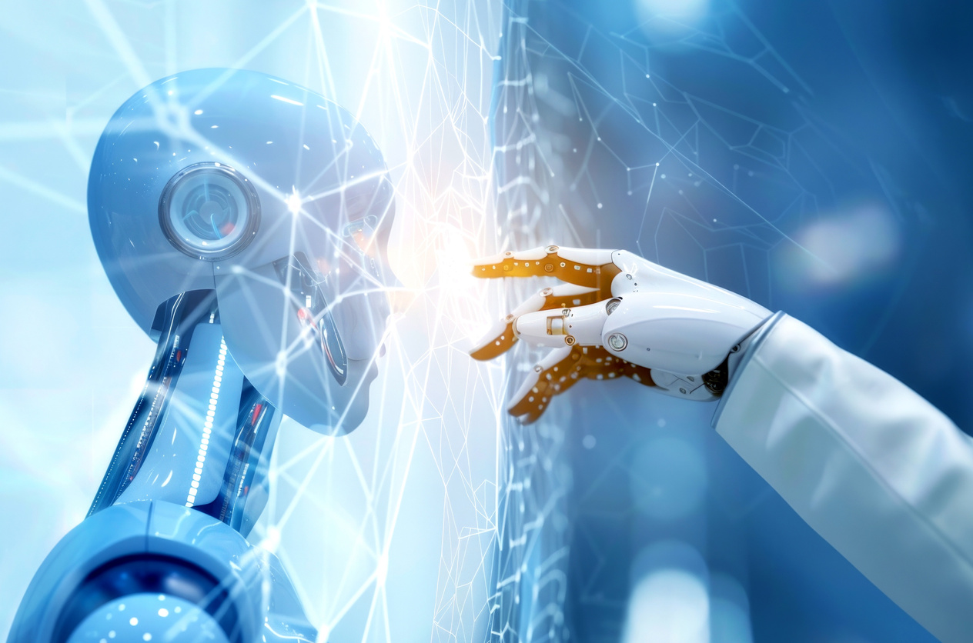
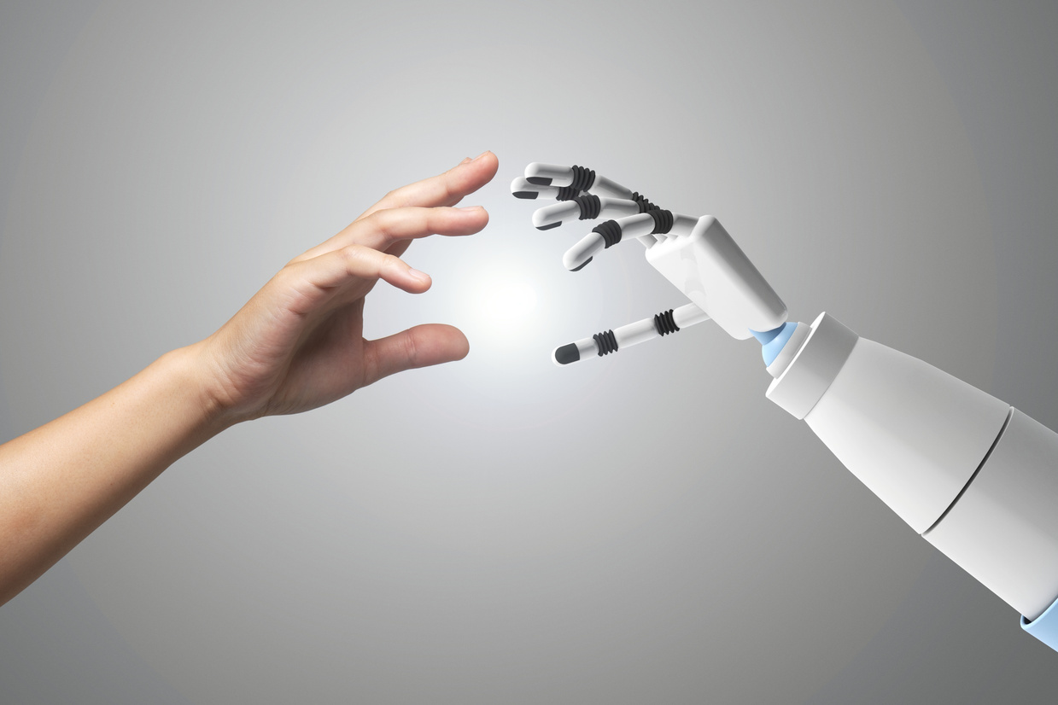
RISKS & HOW WE ADDRESS THEM
Medical safety – risk of tissue damage → solved with biocompatible coating & safe stimulation levels.
Cybersecurity threats – risk of hacking brain signals → solved with encrypted data transmission.
Signal accuracy – brain signals are noisy → solved using deep learning models (CNN/RNN).
Cost scalability – keeping device affordable → solved with efficient manufacturing + modular design.
Regulatory approval – medical device certification → addressed with FDA/CE compliance roadmap.
Notes:
Every innovative technology comes with risks. For MindMotion, we considered medical safety, cybersecurity, signal accuracy, cost, and daily challenges. For each, we designed clear solutions — from biocompatible coatings to advanced AI, encryption, and a compliance roadmap. MindMotion is built not just to work, but to work safely, reliably, and affordably.

Slide 10
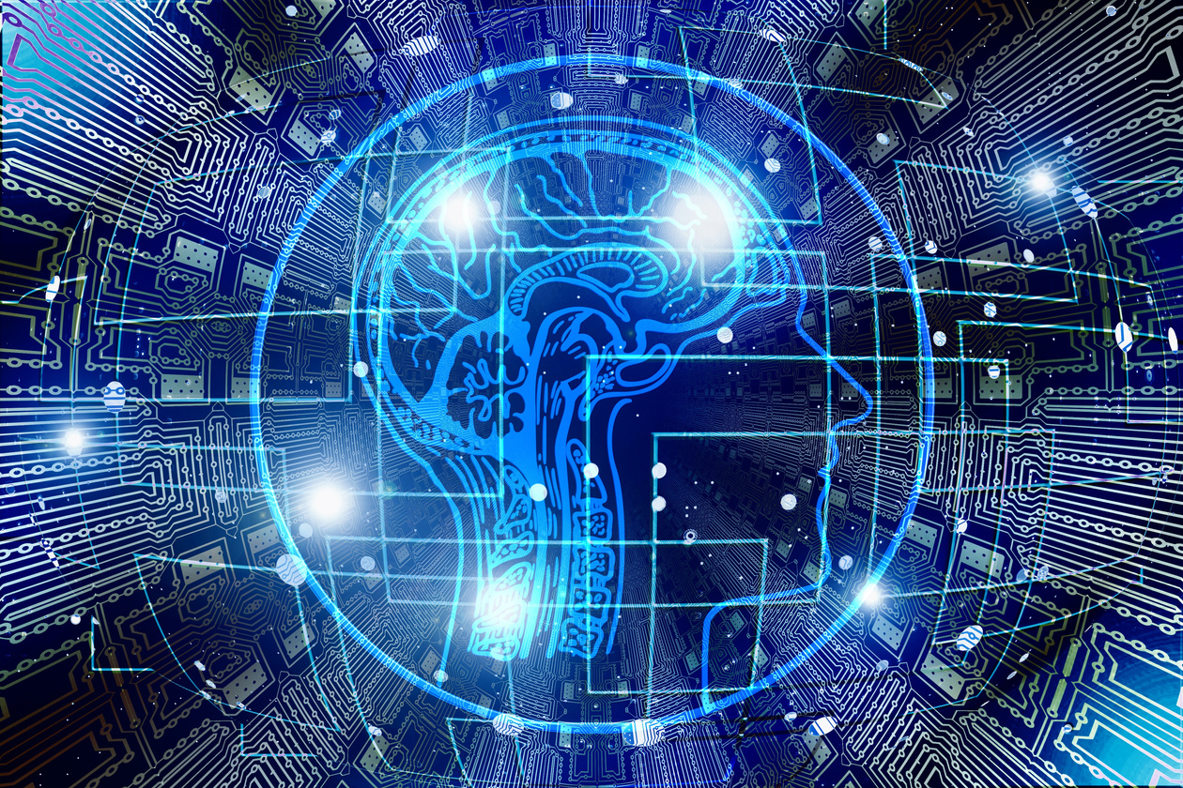
SHAPING THE FUTURE OF HUMAN POTENTIAL
MindMotion isn’t just a chip — it’s hope restored.
From helping stroke survivors to empowering people with paralysis, this technology redefines what’s possible.
With the right support, we can scale from labs to lives — bringing independence back to millions.
Together, we’re not just building technology… we’re building futures.
Notes:
We started with a vision, designing the AI chip and selecting safe, biocompatible materials. We trained our AI model to decode motor imagery signals, ran simulations in Tinkercad and Python, and validated the results. With 90% accuracy, MindMotion isn’t just an idea — it’s a working concept ready for real-world implementation

Slide 11
LARANA, INC.
THANK YOU

